Slide 1
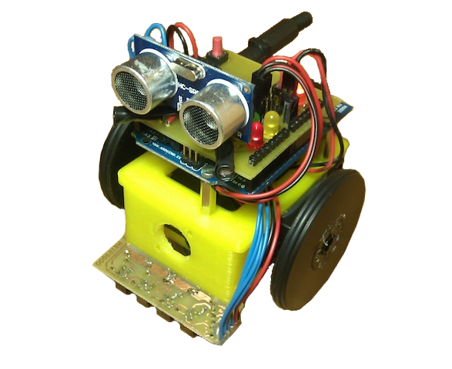
Lesson 2 – Robot assembly
ArduSkyBot 2012 Summer Workshop
Today you will learn:
Components of our robot
How to build the ArduSkyBot!
Simple programming examples
You will program your own sequences!
Organized by: Carlos García Saura
July-August 2012

Slide 2
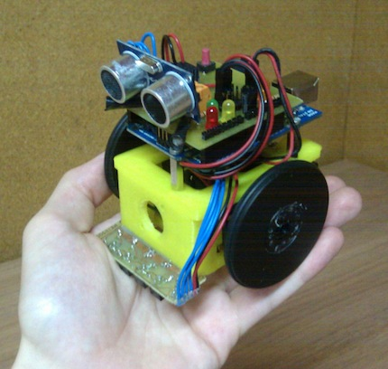
ArduSkyBot's features
Push buttons
Frontal distance sensor
Two light sensors
Lots of LED lights
Speaker
Line sensor

Slide 3
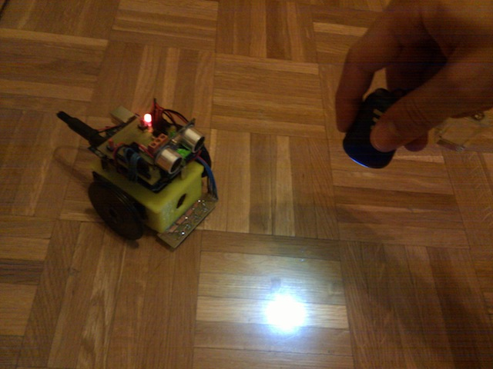
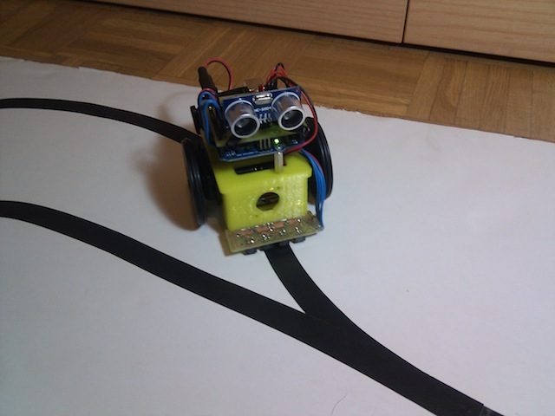
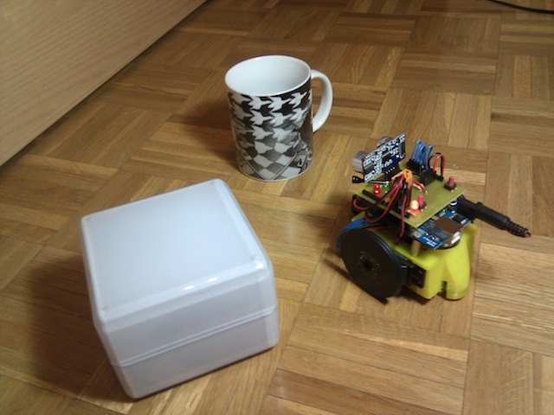
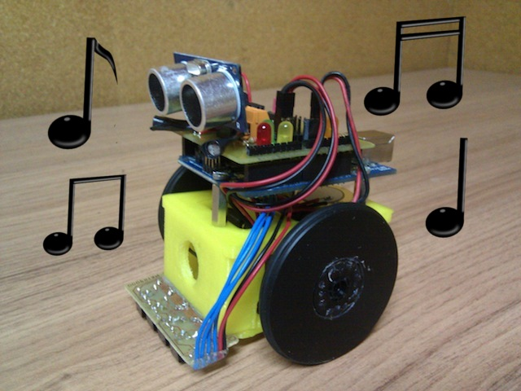
What can the ArduSkyBot do?
Some examples:
Follow light
Line follower
Avoid obstacles
Play music tones

Slide 4
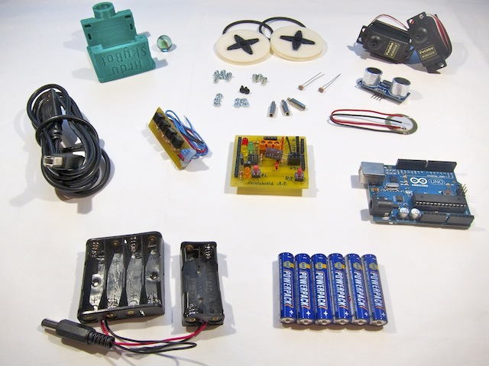
ArduSkyBot kit contents
Light
sensors
Wheels and tires
3D printed
chassis
Servo
motors
Marble
Distance
sensor
Nuts and
bolts
Speaker
CNY70
board
USB cable
Printshield
Battery
holder
Arduino
UNO
6 AAA
batteries

Slide 5
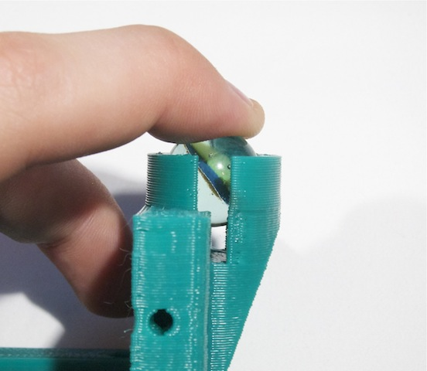
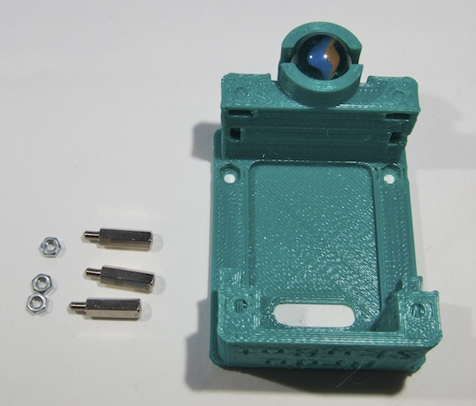
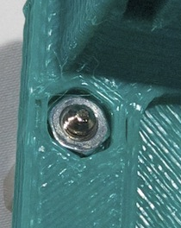
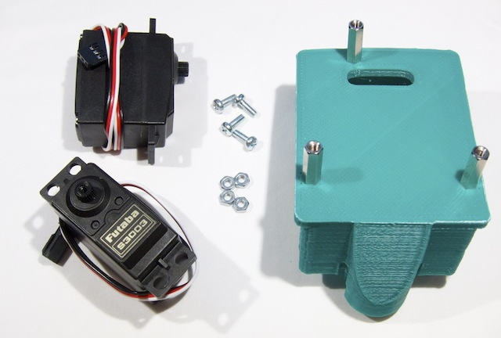
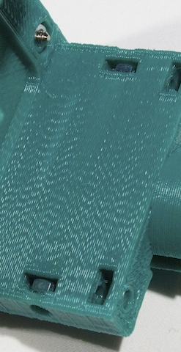
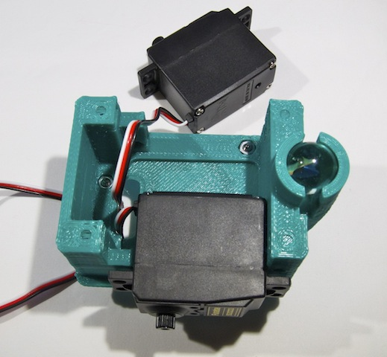
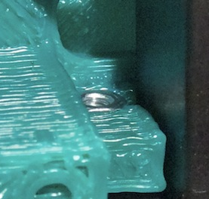
Assembly of the ArduSkyBot (1)

Slide 6
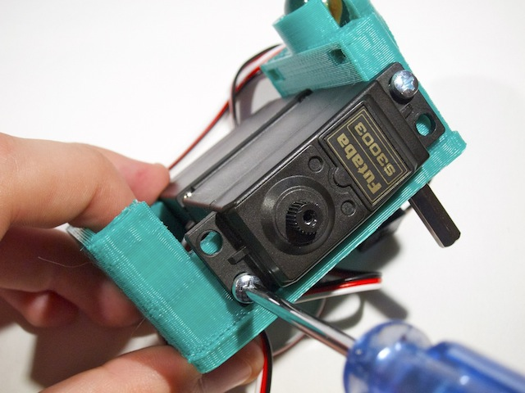
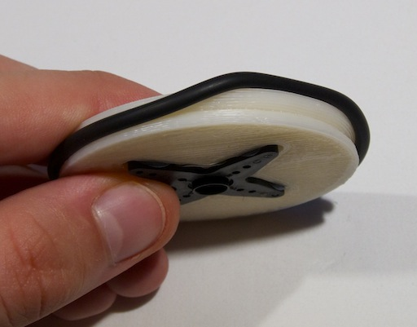
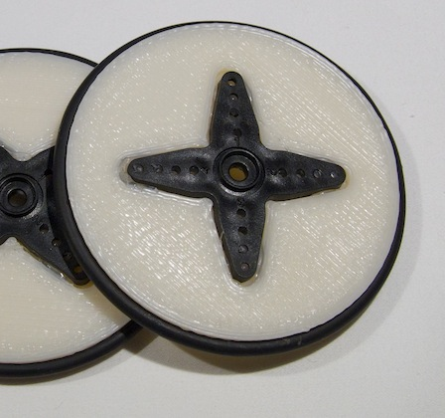
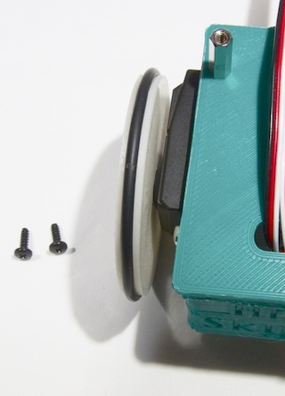
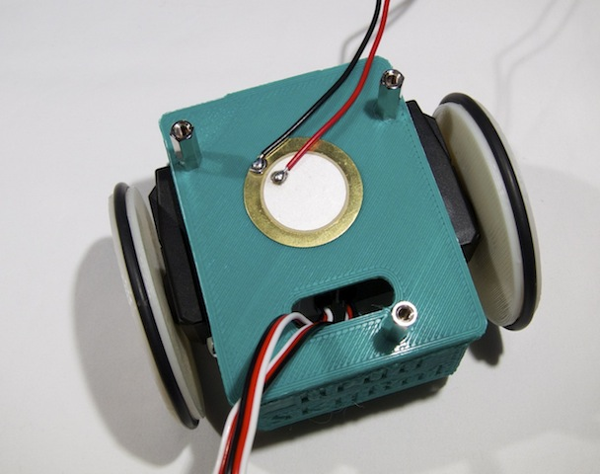
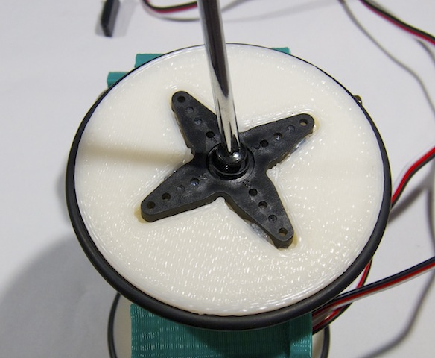
Assembly of the ArduSkyBot (2)
Note cable
orientation!

Slide 7
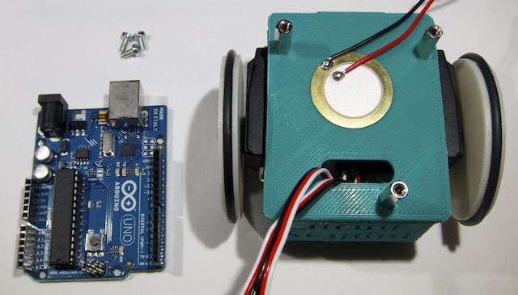
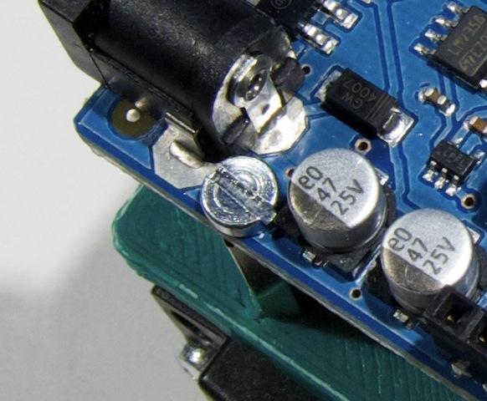
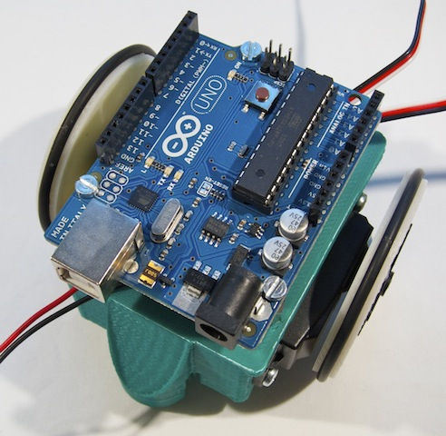
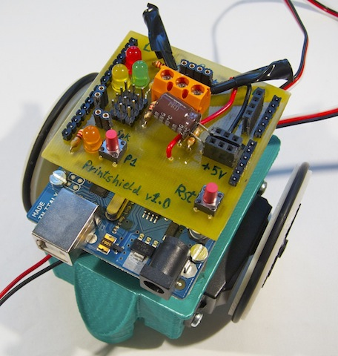
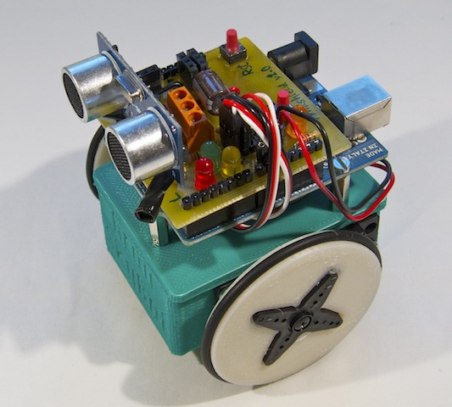
Assembly of the ArduSkyBot (3)

Slide 8
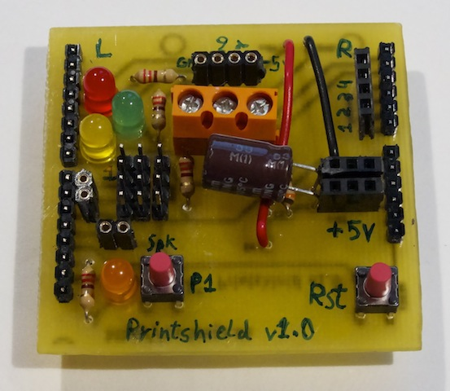
Printshield connections
Distance sensor
Left motor
White/Orange
Cable (signal)
Right motor
Speaker
-
+

Slide 9
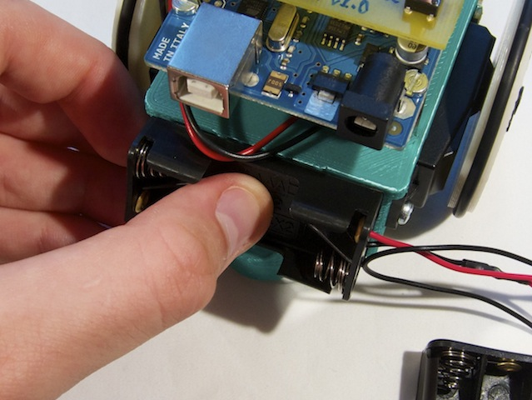
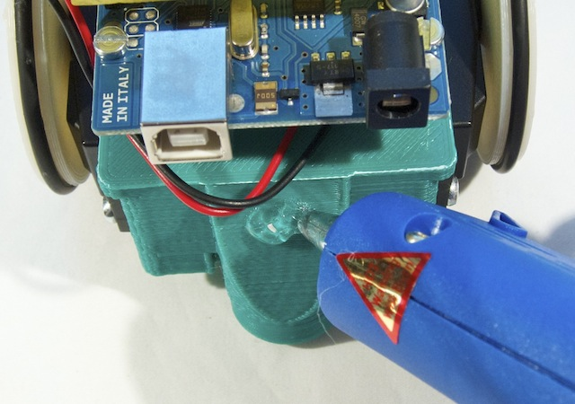
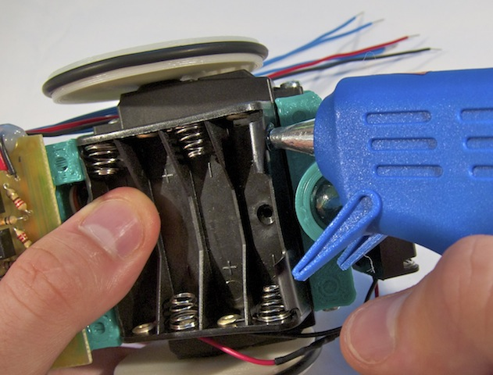
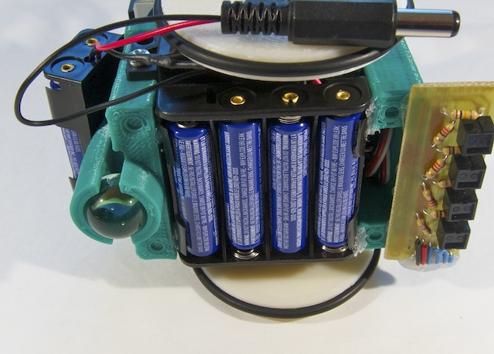
Assembly of the ArduSkyBot (4)

Slide 10
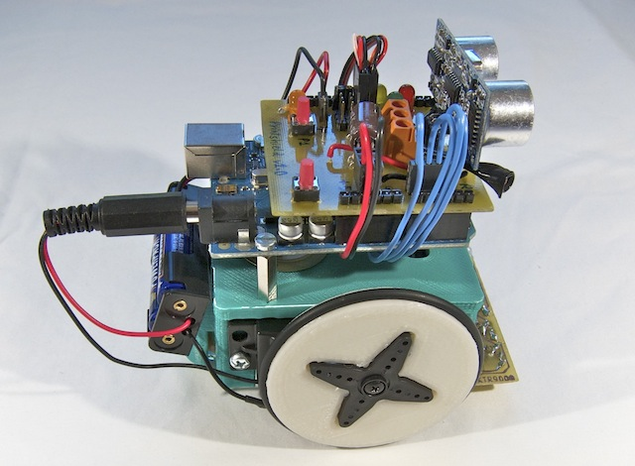
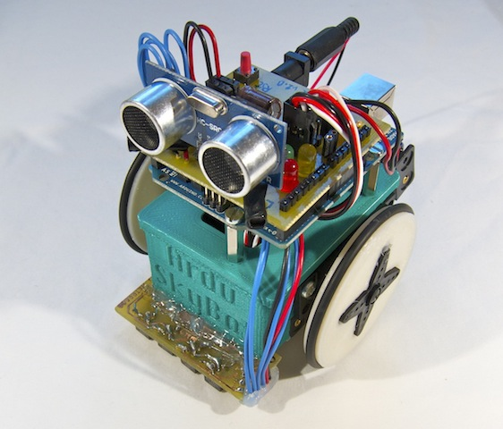
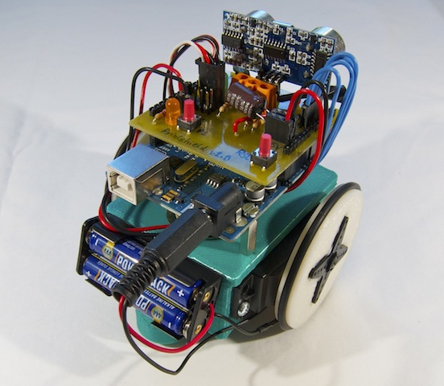
You have built an ArduSkyBot!
We will add the line sensor in following lessons!

Slide 11
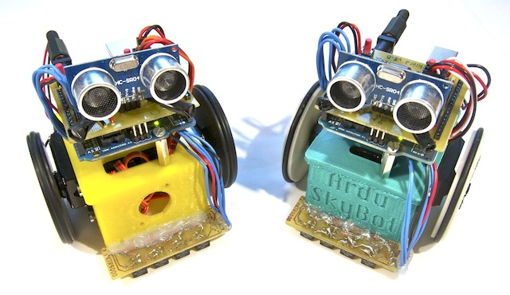
Now we can begin with the programming!
Download the example code from
http://www.carlosgs.es/2012-summer-workshop

Slide 12

License
This work is licensed under the
Attribution - Share Alike
Creative Commons license.
http://creativecommons.org/licenses/by-sa/3.0/
Author:
Carlos García Saura

